Slide 1





Real Estate
POWERBI PROJECT
PRESENTATION BY RADINGOANA PRECIOUS MANTI
JANUANRY 2025

Slide 2
Table of Content
1
2
3
Introduction
Problem Statement
Objective
4
5
6
Data Preparation
Results
Conclusions
7
8
Recommendation
Future Scope

Slide 3
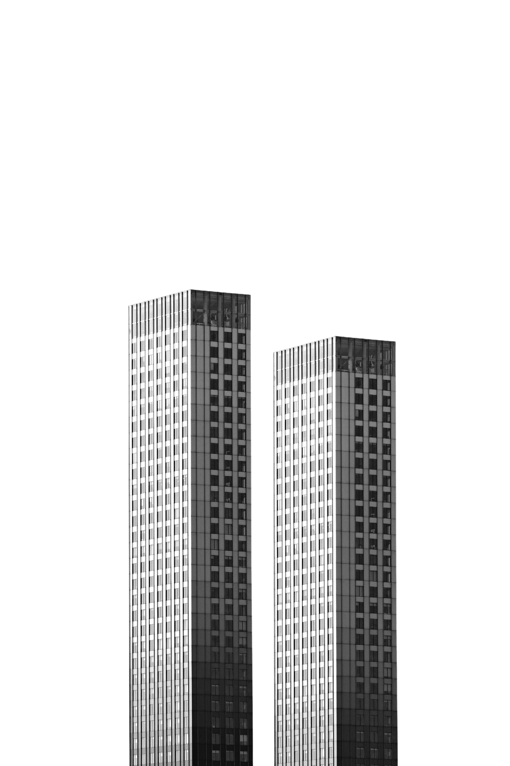

Introduction
Background
In Real estate industry, accurate property evaluation is critical for successful decision-making by investors, owners and real estate professionals.
Proper valuation enables determination of fair market prices, negotiation of deals and assessment of investment opportunities.
Dataset information
The dataset for this project was provided by a real estate company specializing in housing and property sales.
The data offers comprehensive view of resale market in the specified area.

Slide 4
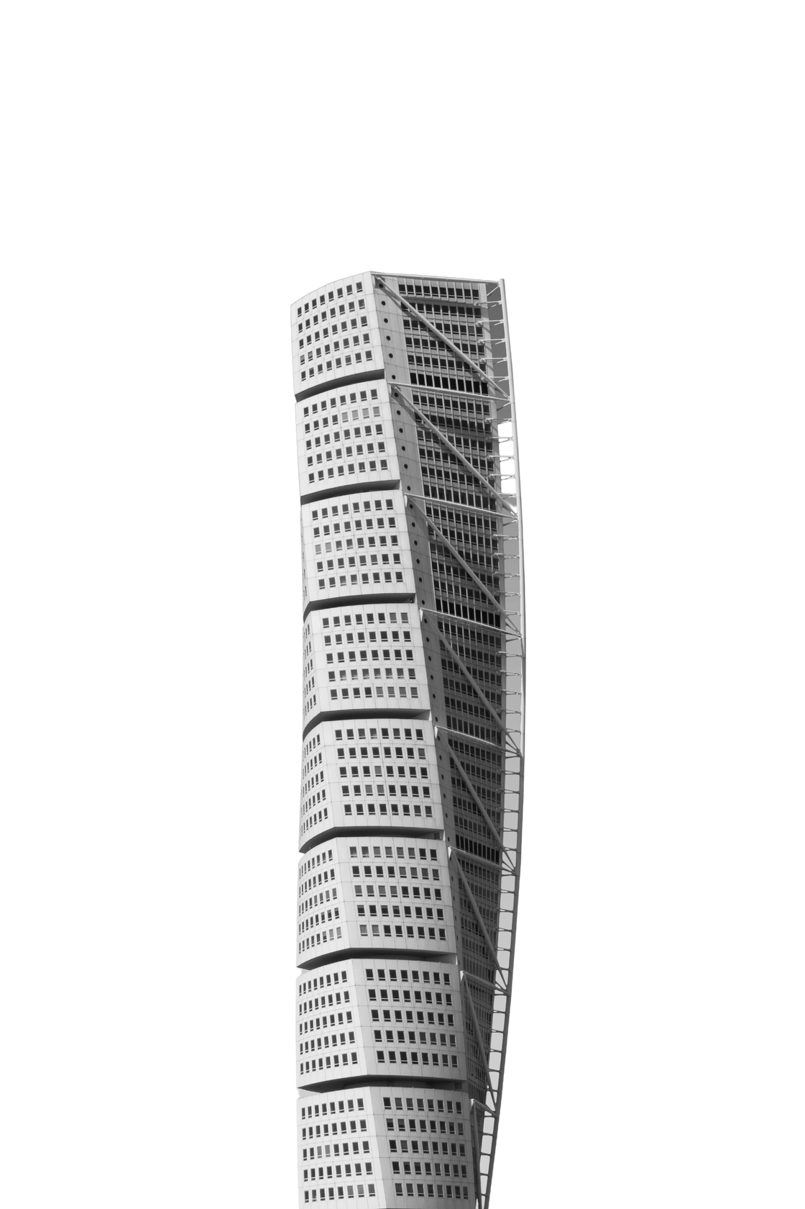
Problem statement
The valuation of properties is complex, its market is influenced by diverse factors such as location, property characteristics and market trends.
Existing tools lack intuitive analysis and visualization capabilities for quick insights and decision-making.

Slide 5


Objective
Develop an intuitive and comprehensive dashboard for descriptive analytics in the real estate industry using PowerBI
User-friendly
Enhance decision-making
Create a user-friendly analytical tool to understand market dynamics.
Informative dashboards that enhance decision-making through advanced data analysis and visualization

Slide 6
Data Preparation
RAW DATA DESCRIPTION
Name | Details
Data shape | 15 columns and 141 546 rows
Column names | block, flat_model, flat_type, floor_area_sqm, lease_commence_date, month, remaining_lease,resale_price, story_range, street_name, town, street_lat, street_lon, town_lat, town_lon

Slide 7
Data Preparation
DATA TRANSFORMATION AND ANALYSIS
Action | Details
New columns | Remaining_lease, yrs, Lease status
Measures | Count of Active Leases, Count of Non-Active, Average Resale Price, Percentage active, Total sum of leases/resale transactions

Slide 8
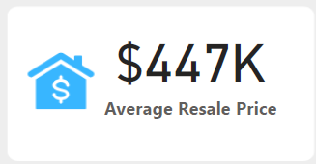
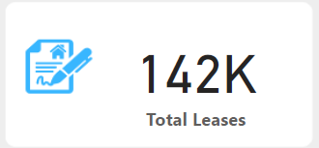
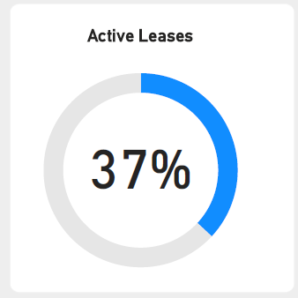
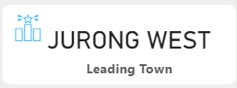
Results
Key Perfomance indicators, KPIs
37% active leases suggests that there is a potential for future resale activities.
The average resale price sits at $447K
Jurong West is the most leading town in terms of resale price

Slide 9
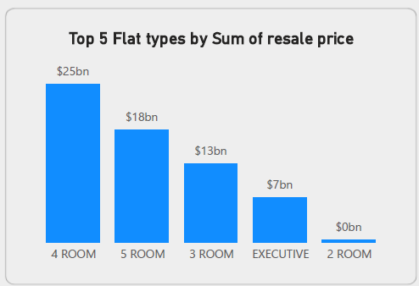
Results
4 Room properties have high resale price with a sum of $12bn
5 room properties follows with a sum resale price of $18bn

Slide 10
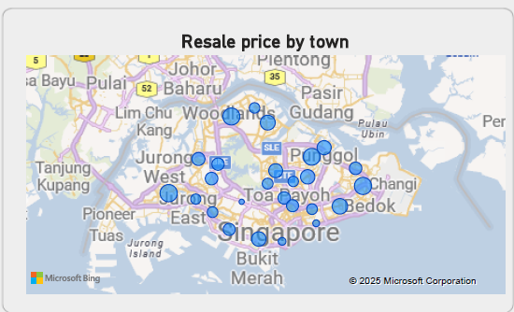
Results
Jurong West is the most leading town in terms of resale price, further analysis shows that is due to 4 room houses and properties with surface area range of 91 - 98 sqm
Other high resale price towns are Tampines, Woodlands, and Sengkang, respectively.

Slide 11
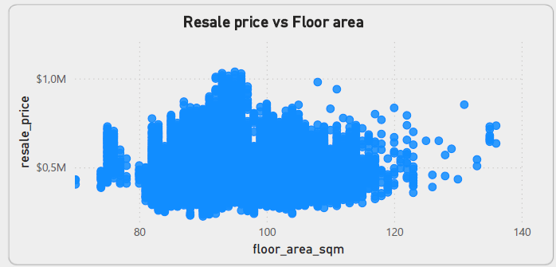
Results
Floor area and resale pricing are correlated, less than 80sqm are cheaper as compared to >85sqm
Lucrative price can be found between 91 and 97 sqm

Slide 12
Conclusions
Real estate market shows preference to 4 room flats especially in towns like Jurong West
There is a positive correlation between floor area and resale pricing i.e larger flats tend to have higher prices
Active leases represent a significant portion of the market, i.e more chances for resale activities
Strategic focus on high-value areas and popular flat types can drive better market

Slide 13
Recommendations
Focus on a 4 room flats
Target Jurong West for investments
Consider floor area in pricing strategy
Monitor active leases
Diversify Investment in Other High-Value Flat Types

Slide 14




Future scope
Implement predictive models to forecast future resale prices based on current trends and historical data
Gather more detailed customer insights to understand the preferences and needs of buyers, which can help in tailoring offerings and marketing strategies.

Slide 15

Ending

